Slide 1
Applied Studies - Design in Wood
Year 9 and/or 10

Slide 2
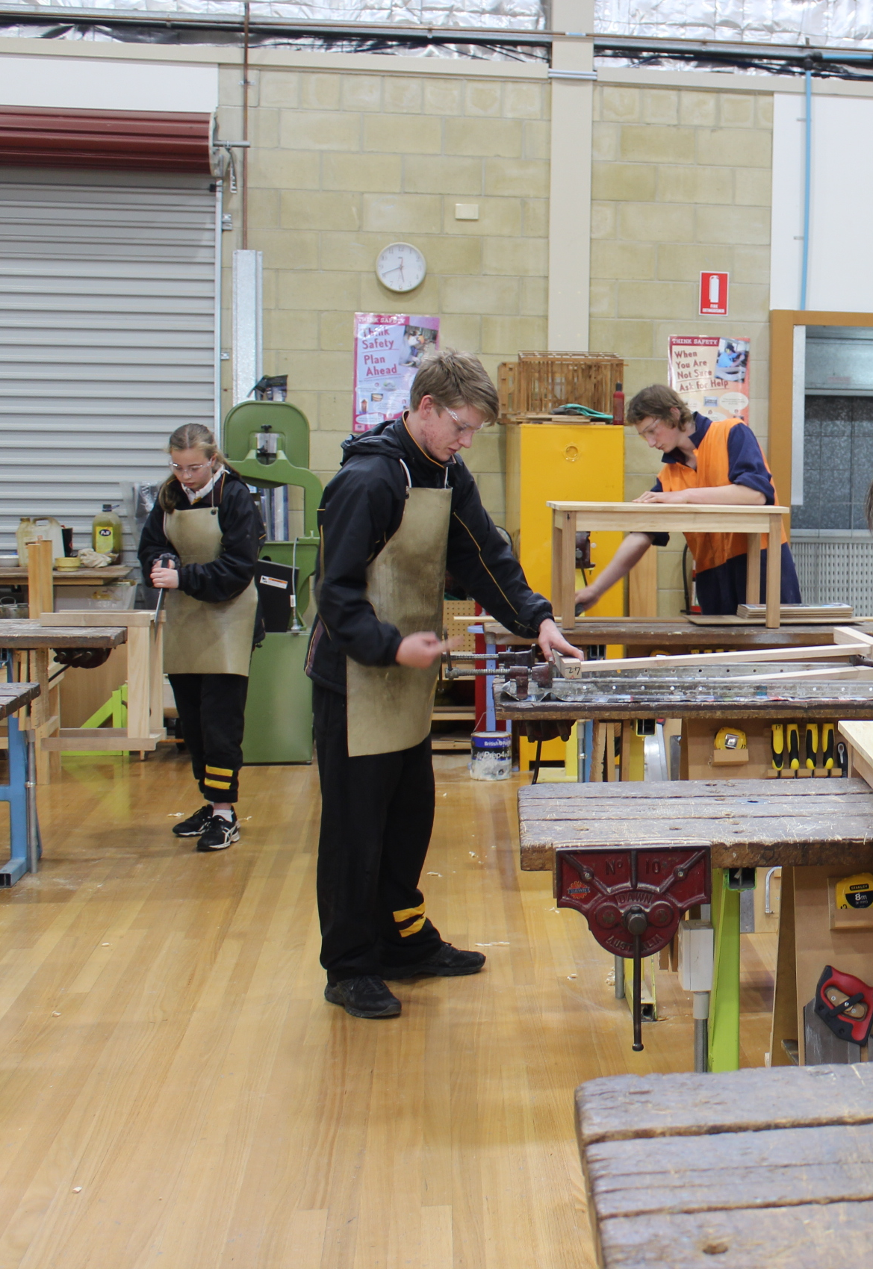
Design in Wood
1 or 2 year course
Prepares students for a Construction pathway
Expands on skills learnt in Year 8 Design in Wood
Recommended this subject is taken in Year 9 if planning to enroll in the Intro to Construction (VET) Course in Year 10
Focus on wearing Personal Protective Equipment (PPE) and Workshop Safety

Slide 3
Find out more…
Please feel free to contact Mrs Selina Kinne, Head of Technology and Applied Studies, at skinne@dominic.tas.edu.au

